Slide 1
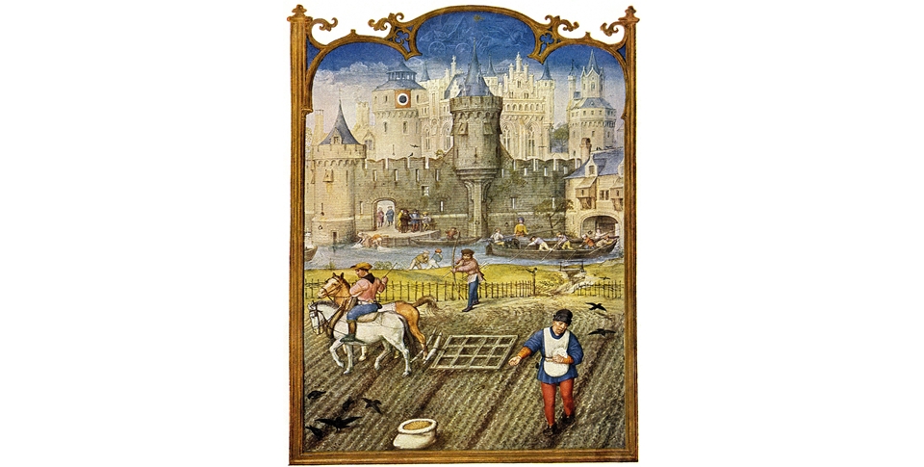
Medieval Christian Europe (330–1450)
Lesson 4 Economic Expansion and Change: The Crusades and After

Slide 2
Medieval Christian Europe (330–1450)
Lesson 4 Economic Expansion and Change: The Crusades and After
Learning Objectives
Summarize how new technologies sparked an agricultural revolution, and the revival of trade led to the growth of towns and cities.
Explain how a commercial revolution changed society and how guilds led to the rise of the middle class.
Explain the causes and effects of the Crusades.
Summarize how Christians in Spain carried out the Reconquista.

Slide 3
Changes in Agriculture Transform Europe
Farming Technology Improves
They are using iron plows instead of wood
They are using a new harness that works for horses versus oxen
Food Output and Population Grow
Start with a 3 field rotation. One with grain, one with legumes, leave the 3rd alone.
Legumes add protein to their diet
It allows for 2/3 of the fields to be used instead of half
Lords, to increase farm land and profit, are going to cut forests, drain swamps
This will increase population

Slide 4
Changes in Agriculture Transform Europe
New farming technologies changed medieval Europe. In the fields, a new type of harness distributed pressure along the shoulders of the horse, which allowed the plowing of heavier soils.

Slide 5
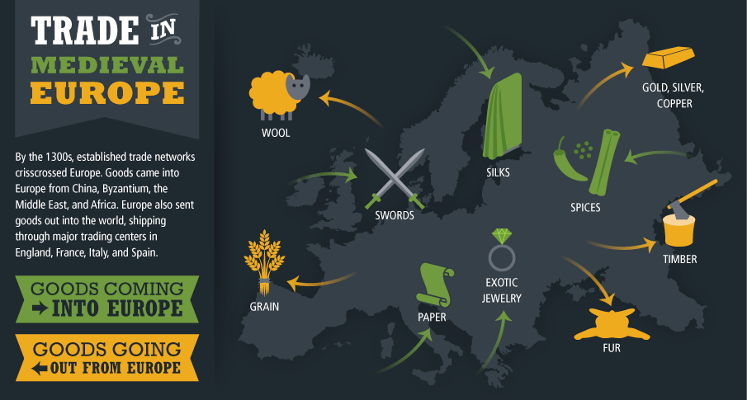
Trade Expands and Towns Grow
Active trade routes brought in new ideas as well as new goods.

Slide 6
Trade Expands and Towns Grow
New Trade Routes
In Constantinople merchants buy: Chinese silks, Byz gold jewelry, and Asian spices
Merchants ship goods to Venice, then pack them on mules to Flanders
There they are sold at trade fairs and sent to England and the Baltic countries
There those goods are paid with honey, furs, cloth, tin, and lead.
Trade Fairs and the Hanseatic League
Trade fairs happened on rivers and where trade routes met
They are going to decline because of the Hanseatic League
The Hans. League is a band of German towns who get rid of pirates and boost trade in furs, timber, and fish.

Slide 7
Trade Expands and Towns Grow
Towns and Cities Expand
Near these trade fairs cities are going to grow
They are going to ask for charters, a document that allows them to rule their city in peace.
In exchange they are going to pay a fee and taxes to the lord of the land
Town and City Life
Narrow streets and tall houses
Smelly, noisy, and crowded, no sanitation, fire hazards b/c homes are made of wood
People are still going to move their for opportunities

Slide 8
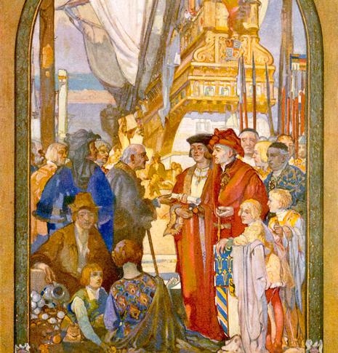
Trade Expands and Towns Grow
A charter acted as a grant to build on private property and to establish trade in exchange for a tax paid to the landowner. Here, a town receives its charter.

Slide 9
Economic Changes
New Ways of Doing Business
They are going to develop partnerships
They are going to develop a new type of insurance called underwriting
They are going to develop something called letters of credit
Changes Affect Medieval Society
With new cities needing food, peasants are going to sell it to them for money
They are going to use that money to pay for rent versus the hard labor they had to do
A new class is going to develop, called the middle class, made up of artisans, merchants, and traders

Slide 10
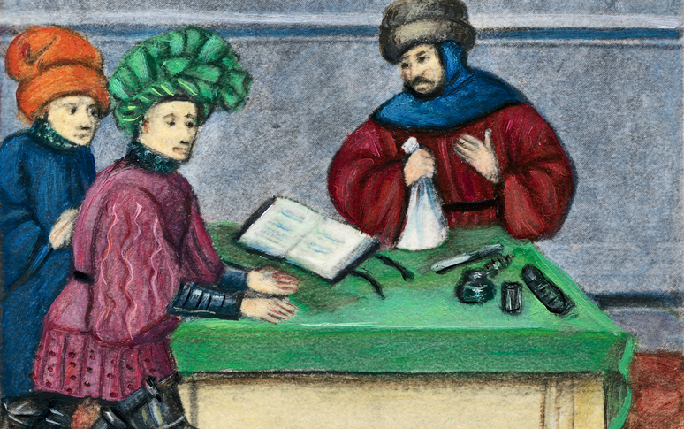
Economic Changes
This image shows banking operations in the 1400s. The man at the right is depositing a bag of gold.

Slide 11
A New Middle Class
Guilds Shape Town Life
Towns have merchants create associations called guilds
They collect taxes, make laws, and decide what town improvements
Artisans are going to resent merchant guilds and create their own guilds
Guilds have limited memberships
Guilds are going to set prices, set hours of labor, and quality of goods
Guilds will provide social services
Becoming a Guild Member
Young children (7-8) would be sent to a guild master to work for a number of years learning. They would be called apprentice
After a number of years they would be journeyman
They would be paid low enough to not be able to open their own shops

Slide 12
A New Middle Class
Women in the Guilds
Could become guild master if they knew the craft well enough and kept the shop going
Some eventually had all female guilds
In Paris they outnumber men in silk and wool guilds
Middle Class Family Life
Had to buy food, didn’t grow it
Had to make good throughout the year
Children were apprenticed or sent to schools in town

Slide 13
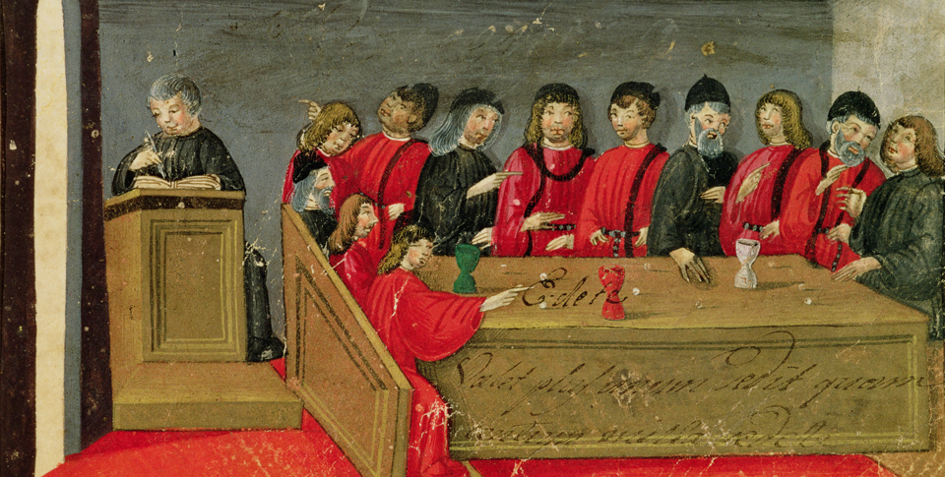
A New Middle Class
This Italian painting from the 1300s shows guild members meeting to discuss issues important to the guild and the town.

Slide 14
The Crusades
Conflict in the Holy Land
The Seljuk Turks are going to invade the Holy Land which is controlled by the Byz
Byz Emperor Alexius I is going to ask the Pope Urban II for help by sending knights
The Pope will agree
The Pope Calls for War
Pope Urban II is going to call for a crusade to free The Holy Land
People will go
People are going for religious reasons, to win wealth and land, to escape problems at home and for adventure
Pope Urban is hoping to increase his political power and heal the Schism between the Roman Catholic Church and the Greek Orthodox Church

Slide 15
The Crusades
Waves of Crusaders Head Eastward
Only the 1st Crusade will come close of achieving its goals. It frees Jerusalem and creates 4 small Christian states around it
The 3rd Crusade will allow Christian pilgrims to enter Jerusalem after they lose it to the Muslim
The Christians will try and take North Africa and fail as well
The 4th Crusade will see the Christian knights sack Constantinople
All lands taken by the Christians will be retaken by the Muslims

Slide 16
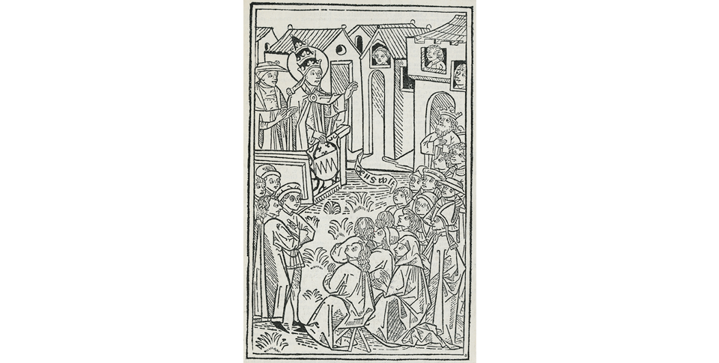
The Crusades
Pope Urban II blesses crusaders leaving on the First Crusade.

Slide 17
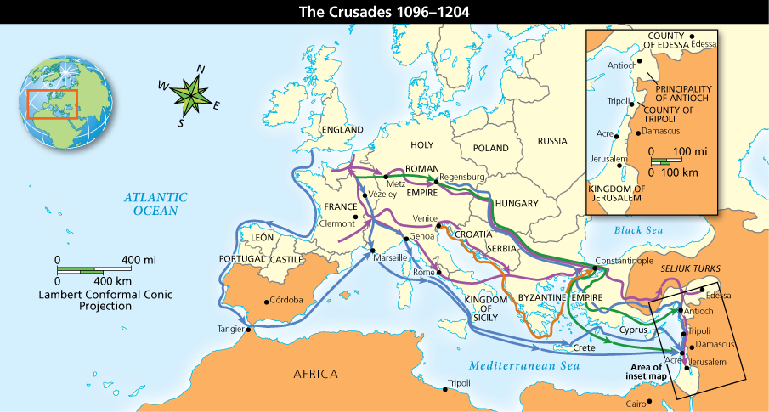
The Crusades
Analyze Maps Urged on by Pope Urban II, thousands of Europeans joined the Crusades to expel Muslims from the Holy Land. What route did English crusaders take? Why do you think they took that route?

Slide 18
The Effects of the Crusades
A Growing Demand for Goods
With the Crusaders coming back home with more spices and perfumes more demand is created for those goods
Venice and other Italian cities are going to build ships to transport Crusaders and use those ships to bring back commodities
Growth of a money economy. Nobles need money to get to the Holy Land. They allow peasants to pay for rent with money instead of labor and goods. Peasants will sell food to town for coin. This will undermine serfdom

Slide 19
The Effects of the Crusades
Changes for Monarchs and the Church
Monarchs will gain the ability to collect taxes to support government. Some will also lead Crusades to enhance their prestige
Catholic Church reaches the height of its power during the Crusades. It will not heal the Schism between churches with the sack of Constantinople. It will also fight with some European monarchs because of its power
Europe Gains a Wider View of the World
Contact with Muslims will make European realize that there is more of the world they haven’t seen
Marco Polo will go to China with his uncle and write about his experience on his way there, life in China, and his trip back
Trade with China and India will lead to a new age of exploration

Slide 20
The Effects of the Crusades
Impact on the Middle East and the Byzantine Empire
There is political conflict with Muslim forces, only the Crusades will serve as a way of uniting them. As soon as they stop fighting the Christians, they start fighting themselves
The Byz Empire is going to slowly collapse. Its going to fall to the Ottoman Turks in 1453 who are led by Mehmet II

Slide 21
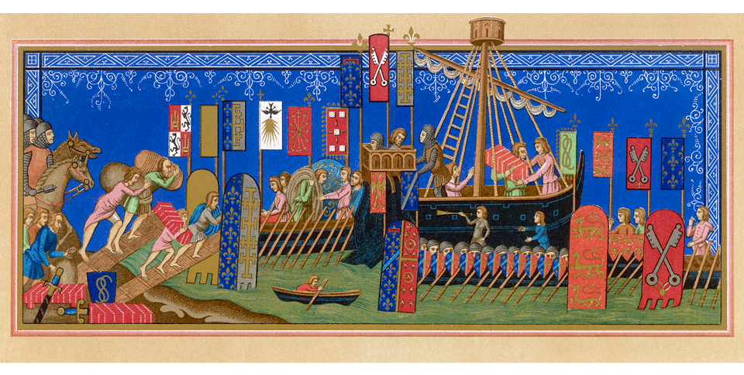
The Effects of the Crusades
Crusaders returned to Europe with spices, perfumes, and other trade goods from the Middle East, and trade began to grow.

Slide 22
The Reconquista
Christian Forces Advance
Spain is going to start the Reconquista by taking Toledo in 1085
By 1300 the Christians are going to control all of the Iberian Peninsula except Grenada
In 1469 Ferdinand of Aragon marries Isabella of Castile and together they create the country of Spain
In 1492 Grenada falls, leaving the monarchs to impose unity on their people
Spain Forces Non-Christians to Leave
Isabella creates the Inquisition
Muslims and Jews are told to convert to Christianity or leave Spain
If they convert they are observed. If they are suspected of practicing their former religion they are tried by the Inquisition
If found guilty they are tortured or burnt at the stake
Thousands are going to leave but these are the people who contribute to Spain’s economy and culture

Slide 23
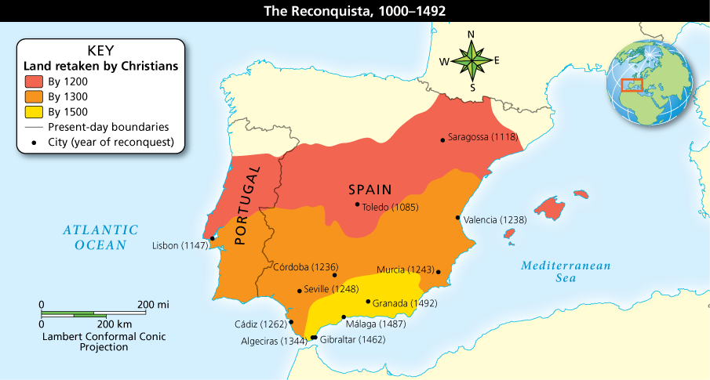
The Reconquista
Analyze Maps The Reconquista took many years and reflected political changes in Spain. The union of Ferdinand and Isabella and their countries gave their forces the power to take back most of Spain. How did the union of the countries of Castile and Aragon help the Reconquista?

Slide 24
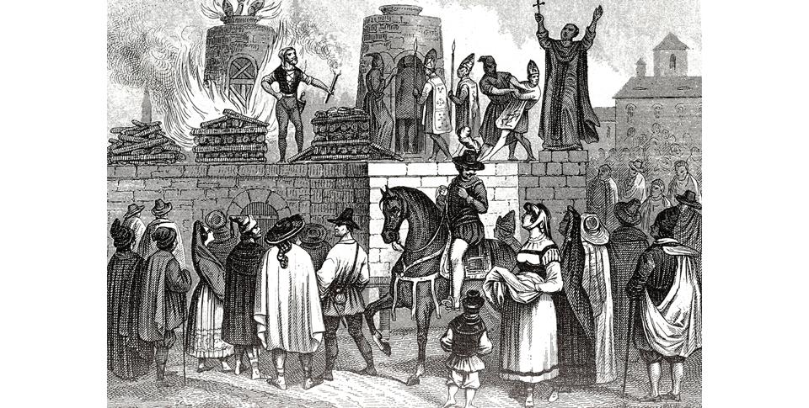
The Reconquista
A later illustration shows prisoners being led to the stake during the Inquisition.

